Slide 1


Restaurant Recommender System- Sydney
IBM Capstone Project

Slide 2
Introduction
Sydney is the state capital of NSW and the most populous city in Australia. It has very diverse population as people migrated from different part of world. Food is an integral part of any culture and with migration Sydney is enriched with variety of cuisines.
As there is variety of cuisines available here, it becomes very important to find an authentic place to eat which is reasonable. Restaurant recommendation seems quite helpful here.
Target audiences for this project does not limit to a person who loves to try food from their own place but everyone. People could simply decide to look for a similar restaurant all the time because they are addicted to a specific category of food.
With restaurants evolving, new food categories emerge, hybrid food starts to become more popular, we need a system that could help us access vast number of food varieties.

Slide 3
Data Requirement
To find a solution to the questions and build a recommender model, we need data and lots of data. Data can answer question which are unimaginable and non answerable by humans because humans do not have the tendency to analyze such large dataset and produce analytics to find a solutions.
Let's consider the base scenario :
Suppose i want to find a restaurant, then logically, i need 3 things :
1)Its geographical coordinates(latitude and longitude) to find our where exactly it is located.
2)Population of the neighborhood where the restaurant is located.
3)Average income of neighborhood to know how much is the restaurant worth.

Slide 4
Data Collection
Collecting geographical coordinates is not difficult but after googling for few days, it was not available on open source data websites such as wikipedia, census report websites etc. Hence I created my own dataset, where I selected all the suburbs in Sydney city and googled their latitude and longitude. Here is the link of the website from where I got the suburbs data : https://www.cityofsydney.nsw.gov.au/learn/research-and-statistics/the-city-at-a-glance This same link provided the information about population and income. This is how the data frame looks like:

Slide 5
Data Collection
Four Square API
Use of foursquare is focused to fetch nearest venue locations so that we can use them to form a cluster. Foursquare api leverages the power of finding nearest venues in a radius(in my case : 500 mts) and also corresponding coordinates, venue location and names. After calling, the following data frame is created:

Slide 6
Methodology
Exploratory Analysis
Scrapping the data from different sources and then combining it to form a single-ton dataset is a difficult task. To do so, we need to explore the current state of dataset and then list up all the features needed to be fetched.

Slide 7
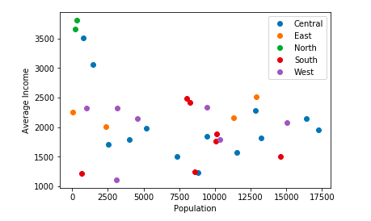
Methodology
Inferential
Most important factors while building the recommender system were population and income. They are the most import factor because they have a nonlinear relationship according to our dataset.

Slide 8
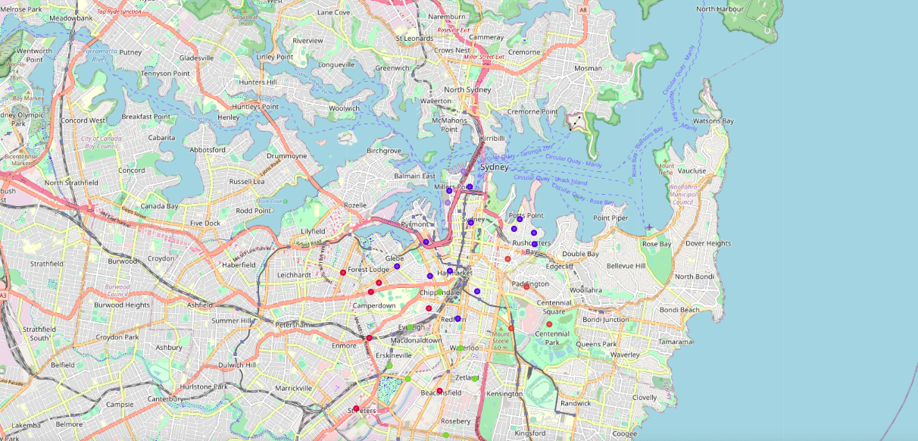
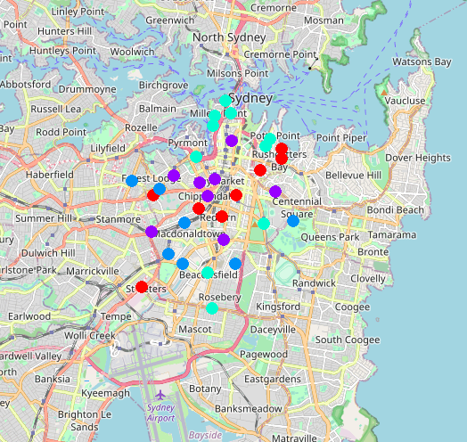
Mapping & Clustering
Since there was a nonlinear relationship between income and population, it can be concluded that we must always perform inferential approach to find relationship among different set of features. Also during clustering, similar neighborhoods must be dumped into the right cluster.

Slide 9
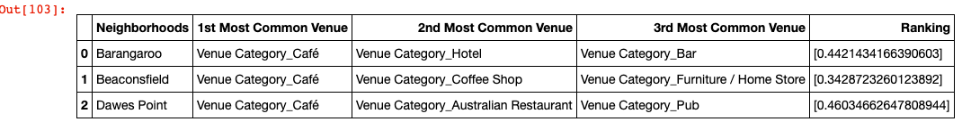
Results
The result of the recommender system is that it produces a list of top restaurants and the most common venue item that the user can enjoy.

Slide 10
Conclusion
The recommender system is a system that considers factors such as population, income and makes use of Foursquare API to determine nearby venues. It is a powerful data driven model whose efficiency may decrease with more data but accuracy will increase. It will help users to finish their hunger by providing the best recommendation to fulfill all their needs.

